Slide 1
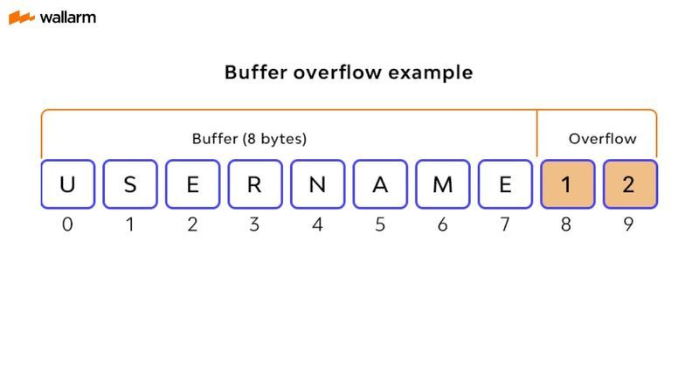
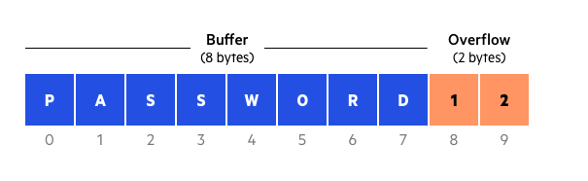
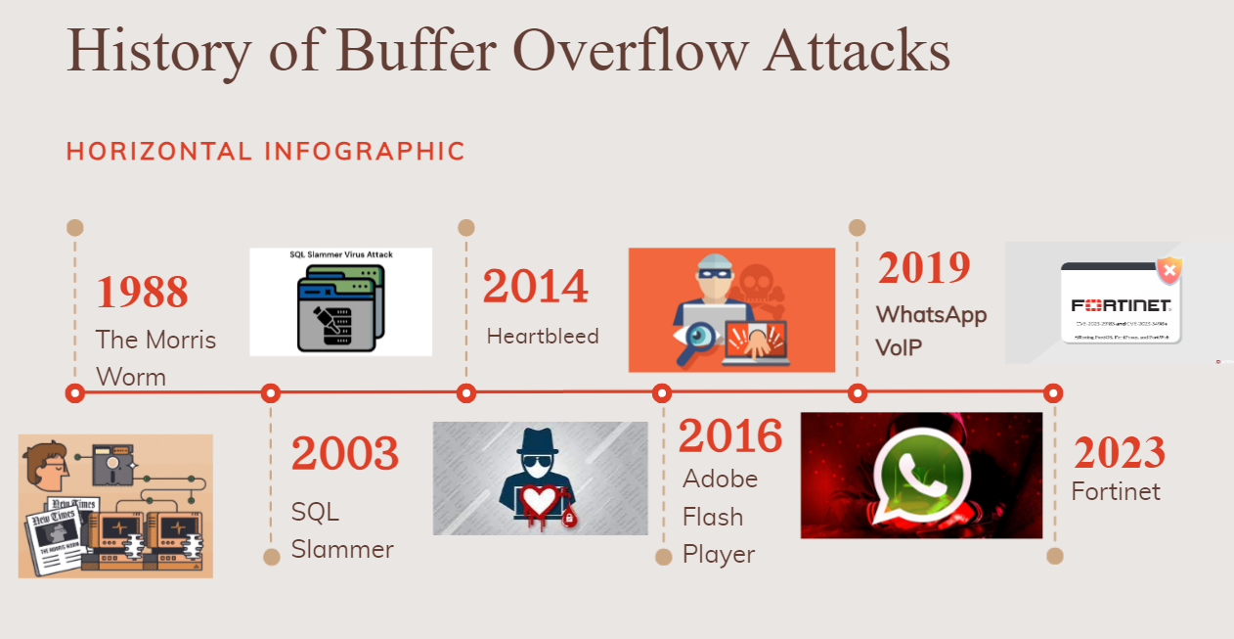
Buffer Overflow Attacks:
The History and How They Work
An IRC by Drake Sims
Being Presented on April 4th, 2024, at 3:00 P.M.
Abstract:
Buffer overflow attacks are one of the most common exploits used by hackers to gain access to a computer, allowing these hackers to corrupt files, gain root access to a computer, gain sensitive information, and much more. These attacks are responsible for millions of computers infected, millions of dollars in damages, and tons of information stolen. Although buffer overflow attacks have been written about since 1972, and first acted upon in 1988, these attacks still occur very often. A simulation of buffer overflow attack can be done following the article “Smashing the Stack in the 21st Century”.
What is a Buffer Overflow Attack?
A buffer overflow occurs when a program’s allocated buffer of memory is filled fully and there is still more data waiting to be put in the buffer. This is shown on the two examples on the left. Once that buffer is filled, the remaining data starts to overflow the buffer. If a hacker wanted to get into this program, they would now fill the overflow of the buffer with executable or harmful code. This is how an attack starts.
https://www.wallarm.com/what/buffer-overflow-attack-definition-types-use-by-hackers-part-1
https://www.imperva.com/learn/application-security/buffer-overflow/
History of Buffer Overflow Attacks
Damages Caused from Buffer Overflow Attacks:
10% of the internet infected by the Morris Worm
SQL Slammer caused 75,000 computers to be infected in only 10 minutes
Heartbleed caused $500 million worth of damages
1,400 phones were infected with malware due to the WhatsApp VoIP attack
Buffer Overflow Prevention:
Today buffer overflow attacks are harder to execute than ever thanks to many modern protections in programs. The protections found in these programs have made it extremely difficult to execute buffer overflow attacks, due to a protection called “runtime bounds checking”. Runtime bounds checking keeps track of how much space is left in a buffer. If a buffer is filled and there is still more data coming in an error is thrown causing the program to stop and ask for a new input or crash all together. Most modern programs have adopted protections as this one, but some programs still try to get by without using them due to the performance loss on a program. However, programs developed using the C programming language are especially susceptible. It is incredibly important that computer users keep their applications and operating systems up to date to prevent them from becoming a victim to a buffer overflow attack
Works Cited
“Adobe Flash Security Issues | Player Problems | SWF Vulnerabilities.” Locklizard, www.locklizard.com/adobe-flash-security/.
Banach, Zbigniew. “The Heartbleed Bug: How a Forgotten Bounds Check Broke the Internet.” Www.invicti.com, 7 Feb. 2020, www.invicti.com/blog/web-security/the-heartbleed-bug/.
Gupta, Samanvay. “Buffer Overflow Attack.” IOSR Journal of Computer Engineering, vol. 1, no. 1, 2012, pp. 10–23, https://doi.org/10.9790/0661-0111023.
L, Widad. Fortinet Releases Updates to Patch High-Severity Vulnerabilities in Multiple Products - AYRIME. 15 Sept. 2023, ayrime.com/news/fortinet-releases-updates-to-patch-high-severity-vulnerabilities-in-multiple-products/. Accessed 31 Mar. 2024.
Lhee, Kyung-Suk, and Steve J. Chapin. “Buffer Overflow and Format String Overflow Vulnerabilities.” Software: Practice and Experience, vol. 33, no. 5, 2003, pp. 423–460, https://doi.org/10.1002/spe.515.
Orman, H. “The Morris Worm: A Fifteen-Year Perspective.” IEEE Security & Privacy, vol. 1, no. 5, Sept. 2003, pp. 35–43, https://doi.org/10.1109/msecp.2003.1236233.
“Real Life Examples.” Towson.edu, 2014, cisserv1.towson.edu/~cssecinj/links-resources/real-life-examples/.
“The NSO WhatsApp Vulnerability - This Is How It Happened.” Check Point Research, 14 May 2019, research.checkpoint.com/2019/the-nso-whatsapp-vulnerability-this-is-how-it-happened/.
wallarm. “What Is a Buffer Overflow Attack ❓ Types, How Hackers Use It | Wallarm.” Www.wallarm.com, www.wallarm.com/what/buffer-overflow-attack-definition-types-use-by-hackers-part-1.
Welekwe, Amakiri. “Buffer Overflow Vulnerabilities and Attacks Explained.” Comparitech, 24 Aug. 2020, www.comparitech.com/blog/information-security/buffer-overflow-attacks-vulnerabilities/.
“What Is a Buffer Overflow | Attack Types and Prevention Methods | Imperva.” Imperva, 2020, www.imperva.com/learn/application-security/buffer-overflow/.
“What Is SQL Slammer Virus?” GeeksforGeeks, 21 Aug. 2022, www.geeksforgeeks.org/what-is-sql-slammer-virus/.

